Slide 1
Informed Search and Exploration Part II
Instructor: Dr. Wei Ding

Slide 2
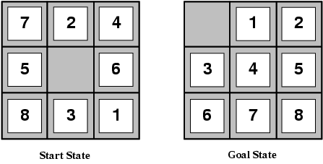
Heuristic Functions
For example,
the average solution cost is about 22 steps
Branching factor ~ 3
4 possible moves when the empty tile is in the middle
2 when the empty tile is in the corner
3 when it is along an edge
Exhaustive search to depth 22 would look at about 3²² ≈ 3.1 * 10¹⁰ states → can be cut down by a factor of about 170,000 by keeping track of repeated states and do not explore non-reachable states
There are only 9!/2=181,440 distinct states that are reachable.
A* search with a well-designed heuristic function may only need to explore less than 2,000 states

Slide 3
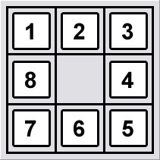
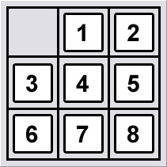
Reachable States of 8-puzzle
The 8-puzzle states are divided into two disjoint sets, such that no state in one set can be transformed into a state in the other set by any number of moves.
For detailed explanation, see http://www.8puzzle.com/8_puzzle_algorithm.html
Only one of the goal states can be reached, given a randomly generated 8-puzzle instance.
Goal State A
Goal State B

Slide 4
Admissible Heuristic
A heuristic function that never overestimates the number of steps to the goal.
h₁= the number of misplaced tiles.
h₁=8 (all the eight tiles are out of position)
h₂=the sum of the distances of the tiles from their goal positions.
h₂= 3+1+2+2+2+3+3+2 = 18 (because tiles cannot move along diagonals, the distance we will count is the sum of the horizontal and vertical distances – city block distance or Manhattan distance)

Slide 5
Admissible Heuristic
h₁ is an admissible heuristic, because it is clear that any tile that is out of place must be moved at least once.
h₂ is also admissible, because all any move can do is moving one tile one step closer to the goal.
So, which heuristic function is better?

Slide 6
Effective Branching Factor b*
If the total number of nodes generated by A* for a particular problem is N, and the solution depth is d, then b* is the branching factor that a uniform tree of depth d would have to have in order to contain N+1 nodes.
N+1 = 1 + b* + (b*)² + …+(b*)^{d}
For example, if A* finds a solution at depth 5 using 52 nodes, then the effective branching factor is 1.92.

Slide 7
Effective Branching Factor b*
The effective branching factor can vary across problem instances, but usually it is fairly constant for sufficiently hard problems.
A well-designed heuristic would have a value of b* close to 1, allowing fairly large problems to be solved.
To test the heuristic functions h₁ and h₂ of the 8-puzzle problem, we generated 1200 random problem instances, the results suggest that h₂ is better than h₁. For example,
d=12 IDS = 3,644,035 nodes, b* = 2.78 A*(h₁) = 227 nodes , b* = 1.42 A*(h₂) = 73 nodes , b* = 1.24
d=24 IDS = too many nodes A*(h₁) = 39,135 nodes, b*=1.48 A*(h₂) = 1,641 nodes, b*=1.26
Of course, this is not an arbitrary result…

Slide 8
Domination
For the two admissible functions h₁ and h₂, h₂(n) ≥ h₁(n) for any node n, we thus say h₂ dominates h₁
Domination translates directly into efficiency: A* using h₂ will never expand more nodes than A* using h₁.
Recall the f-contours of nodes…

Slide 9
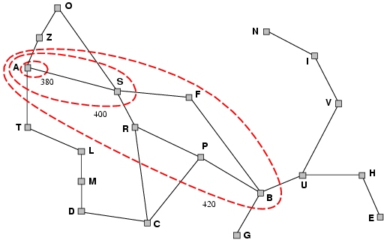
Argument
A* expands nodes in order of increasing f value
Contour i has all nodes with f=f_{i}, where f_{i} < f_{i+1}
Every nodes with f(n)<C* will surely be expanded, where C* is the cost of the optimal solution.
This is the same as saying that every node with h(n)<C*-g(n) will be expanded.
Because h₂ (Manhattan distance) is at least as big as h₁ (misplaced tiles) for all nodes, every node that is surely expanded by A* with h₂ will also surely be expanded with h₁, and h₁ might also cause other nodes to be expanded as well.
It is always better to use a heuristic function with higher values, provided it does not overestimate and that the computation time for the heuristic is not too large.

Slide 10
Inventing admissible heuristic functions
A problem with fewer restrictions on the actions is called a relaxed problem
The cost of an optimal solution to a relaxed problem is an admissible heuristic for the original problem
The heuristic is admissible because the optimal solution in the original problem is, by definition, also a solution in the relaxed problem and therefore must be at least as expensive as the optimal solution in the relaxed problem.

Slide 11
Inventing admissible heuristic functions
If the rules of the 8-puzzle are relaxed so that a tile can move anywhere, then h₁(n) gives the shortest solution
If the rules are relaxed so that a tile can move to any adjacent square, then h₂(n) gives the shortest solution

Slide 12
Example
If the 8-puzzle actions are described as
A tile can move from square A to square B if
A is horizontally or vertically adjacent to B and B is blank
We can generate 3 relaxed problems by removing one or both of the conditions:
A tile can move from square A to square B if A is adjacent to B
A tile can move from square A to square B if B is blank
A tile can move from square A to square B
← Derive h₂
← Derive h₁

Slide 13
Learning heuristic from experience
An inductive learning algorithm can (with luck) predict solution costs for other states that arise during search.
Inductive learning methods work best when supplied with features of a state that are relevant to its evaluation, rather than with just the raw state description.
For example …

Slide 14
Example
Feature x₁(n): the feature “# of misplaced tiles” might be helpful in predicting the actual distance of a state from the goal.
Feature x₂(n): the feature “# of pairs of adjacent tiles that are also adjacent in the goal state.”
A common approach is to use a linear combination: h(n) = c₁x₁(n) + c₂x₂(n)
The constants c₁ and c₂ are adjusted to give the best fit to the actual data on solution costs. Presumably, c₁ should be positive and c₂ should be negative.

Slide 15
Local Search and Optimization: Motivation
The search algorithms that we have seen so far are designed to explore search spaces systematically. When a goal is found, the path to that goal also constitutes a solution to the problem.
In many optimization problems, the path to the goal is irrelevant; the goal state itself is the solution. For example, integrated-circuit design, telecommunications network optimization, etc.

Slide 16
Local search algorithms
If the path to the goal does not matter, we might consider a different class of algorithms, ones that do not worry about paths at all.
Local search algorithms operate using a single current state (rather than multiple paths) and generally move only to neighbors of the state
Typically, the paths followed by the search are not retained.
Although local search algorithms are not systematic, they have two key advantages …

Slide 17
Two key advantages of local search
Use very little memory – usually a constant amount
Can find reasonable solutions in large or infinite (continuous) state spaces for which systematic algorithms are unsuitable
Useful for solving pure optimization problems, in which the aim is to find the best state according to an objective function.
For example, nature provides an objective function –reproductive fitness – that Darwinian evolution could be seen as attempting to optimize, but there is not “goal test” and no “path cost” for this problem.

Slide 18
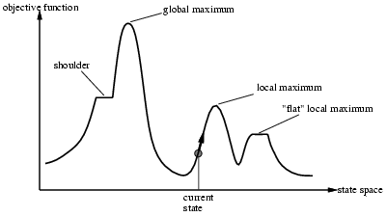
State space landscape
A landscape has both “location” (defined by the state) and “elevation” (defined by the value of the heuristic cost function or objective function)

Slide 19
Hill-climbing search
The hill-climbing search algorithm is simply a loop that continually moves in the direction of increasing value—that is, uphill. It terminates when it reaches a “peak” where no neighbor has a higher value
The algorithm does not maintain a search tree. It only need record the state and its objective function.

Slide 20
Hill-climbing search
Hill-climbing does not look ahead beyond the immediate neighbors of the current state. This resembles trying to find the top of Mount Everest in a thick fog while suffering from amnesia.
Problem: depending on initial state, can get stuck in local maxima

Slide 21
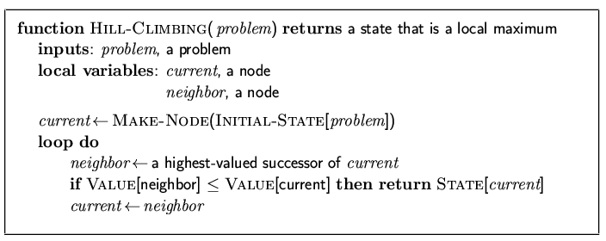
Hill-Climbing
Value of an objective function
If a heuristic cost estimate h is used, we would find the neighbor with the lowest h.

Slide 22

Example: n-queens
Put n queens on an n × n board with no two queens on the same row, column, or diagonal

Slide 23
8-queens problem
local-search algorithms typically use a complete-state formulation
Each state has 8 queens on the board, one per column.
The successor function returns all possible states generated by moving a single queen to another square on the same column.
So each state has 8*7=56 successors

Slide 24
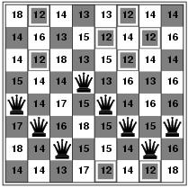
Hill-climbing search: 8-queens problem
h = number of pairs of queens that are attacking each other, either directly or indirectly
h = 17 for the example on the right
The figure shows the value of h for each possible successor obtained by moving a queen within its column
The best moves are marked.
Hill-climbing typically chooses randomly among the set of best successors, if there is more than one.

Slide 25
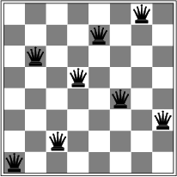
Hill-climbing search: 8-queens problem
To be continued….
A local minimum with h = 1 ☹
Every move a single queen makes the situation worse

Slide 26
Hill climbing
Sometime called greedy local search because it grabs a good neighbor state without thinking ahead about where to go next.
Often makes very rapid progress towards a solution, because it is usually quite easy to improve a bad state.
Unfortunately, hill climbing often gets stuck for the following reasons…

Slide 27
Problems of hill climbing
Local maxima: a peak that is high than each of its neighboring states, but lower than the global maximum.
Shoulder: a flat local maximum, from which no uphill exist exists.
In each case, the algorithm reaches a point at which no progress is being made.

Slide 28
Hill climbing for the 8-queen problem
Starting from a randomly generated 8-queen state
hill climbing gets stuck 86% of the time, solving only 14% of problem instances.
Take just 4 steps on average when it is succeeds and 3 when it gets stuck
Not bad for a state space with 8⁸ ≈17 million states.

Slide 29
Variants of hill-climbing
First-choice hill climbing: generating successors randomly until one is generated that is better than the current state.
Random-restart hill climbing: conducts a series of hill-climbing searches from randomly generated initial states, stopping when a goal is found.

Slide 30
Local Minima Problem
Question: How do you avoid this local minimum?
barrier to local search
starting
point
descend
direction
local minimum
global minimum

Slide 31
Consequences of the Occasional Ascents
desired effect
Help escaping the
local optima.
adverse effect
Might pass global optima
after reaching it
(easy to avoid by
keeping track of
best-ever state)

Slide 32
Boltzmann machines
h
The Boltzmann Machine of
Hinton, Sejnowski, and Ackley (1984)
uses simulated annealing to escape local minima.
To motivate their solution, consider how one might get a ball-bearing traveling along the curve to "probably end up" in the deepest minimum. The idea is to shake the box "about h hard" — then the ball is more likely to go from D to C than from C to B. So, on average, the ball should end up in C's valley.

Slide 33
Simulated annealing: basic idea
From current state, pick a random successor state;
If it has better value than current state, then “accept the transition,” that is, use successor state as current state;
Otherwise, do not give up, but instead flip a coin and accept the transition with a given probability (that is lower as the successor is worse).
So we accept to sometimes “un-optimize” the value function a little with a non-zero probability.

Slide 34
Simulated annealing
Kirkpatrick et al. 1983:
Simulated annealing is a general method for making likely the escape from local minima by allowing jumps to higher energy states.
The analogy here is with the process of annealing used by a craftsman in forging a sword from an alloy.

Slide 35
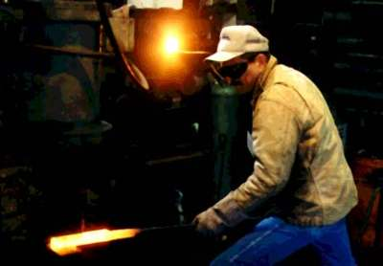
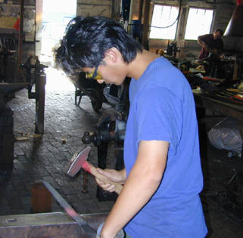
Real annealing: Sword
He heats the metal, then slowly cools it as he hammers the blade into shape.
If he cools the blade too quickly the metal will form patches of different composition;
If the metal is cooled slowly while it is shaped, the constituent metals will form a uniform alloy.

Slide 36
Simulated annealing in practice
Geman & Geman (1984): if temperature T is lowered sufficiently slowly (with respect to the number of iterations used to optimize at a given T), simulated annealing is guaranteed to find the global minimum.
Caveat: this algorithm has no end (Geman & Geman’s T decrease schedule is in the 1/log of the number of iterations, so, T will never reach zero), so it may take an infinite amount of time for it to find the global minimum.

Slide 37
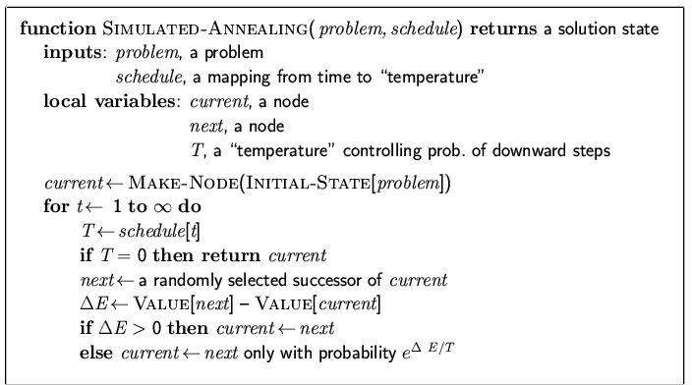
Simulated annealing algorithm
Idea: Escape local extreme by allowing “bad moves,” but gradually decrease their size and frequency.
Note: goal here is to
maximize E.
-exp(ΔE/T)
ΔE<0
If the goal is to minimize E.

Slide 38
Boltzmann distribution
At thermal equilibrium at temperature T, the
Boltzmann distribution gives the relative
probability that the system will occupy state A vs.
state B as:
where E(A) and E(B) are the energies associated with states A and B.

Slide 39
Note on simulated annealing: limit cases
Boltzmann distribution: accept “bad move” with ΔE<0 (goal is to maximize E) with probability P(ΔE) = exp(ΔE/T)
If T is large: ΔE < 0
ΔE/T < 0 and very small
exp(ΔE/T) close to 1
accept bad move with high probability
If T is near 0: ΔE < 0
ΔE/T < 0 and very large
exp(ΔE/T) close to 0
accept bad move with low probability
Random walk
Deterministic
down-hill

Slide 40
Simulated annealing
Different from hill climbing, simulated annealing picks a random move.
If the move improves the situation, it is always accepted. Otherwise, the algorithm accepts the move with some probability less than 1.
The probability decreases exponentially with the “badness” of the move – the amount ΔE by which the evaluation is worsened.
“bad” moved are more likely to be allowed at the start when temperature is high, and they become more unlikely as T decreases.
Simulated annealing is used extensively to solve VLSI layout problems, factory scheduling.

Slide 41
Simulated Annealing Steps
Step 1: Initialize – Start with a random initial placement. Initialize a very high “temperature”.
Step 2: Move – Perturb the placement through a defined move.
Step 3: Calculate score – calculate the change in the score due to the move made.
Step 4: Choose – Depending on the change in score, accept or reject the move. The prob of acceptance depending on the current “temperature”.
Step 5: Update and repeat– Update the temperature value by lowering the temperature. Go back to Step 2.
The process is done until “Freezing Point” is reached.

Slide 42
Algorithm for placement
Algorithm SIMULATED-ANNEALING
Begin
temp = INIT-TEMP;
place = INIT-PLACEMENT;
while (temp > FINAL-TEMP) do
while (inner_loop_criterion = FALSE) do
new_place = PERTURB(place);
ΔC = COST(new_place) - COST(place);
if (ΔC < 0) then
place = new_place;
else if (RANDOM(0,1) > e^{-(ΔC/temp)}) then
place = new_place;
temp = SCHEDULE(temp);
End.

Slide 43
Convergence of simulated annealing

Slide 44
Qualitative Analysis
Randomized local search.
Is simulated annealing greedy?
Controlled greed.
Once-a-while exploration.
Is a greedy algorithm better? Where is the difference?
The ball-on-terrain example.

Slide 45
Ball on terrain example – Simulated Annealing vs Greedy Algorithms
The ball is initially placed at a random position on the terrain. From the current position, the ball should be fired such that it can only move one step left or right.What algorithm should we follow for the ball to finally settle at the lowest point on the terrain?

Slide 46
Ball on terrain example – SA vs Greedy Algorithms

Slide 47
Applications
Circuit partitioning and placement.
Strategy scheduling for capital products with complex product structure.
Umpire scheduling in US Open Tennis tournament!
Event-based learning situations.

Slide 48
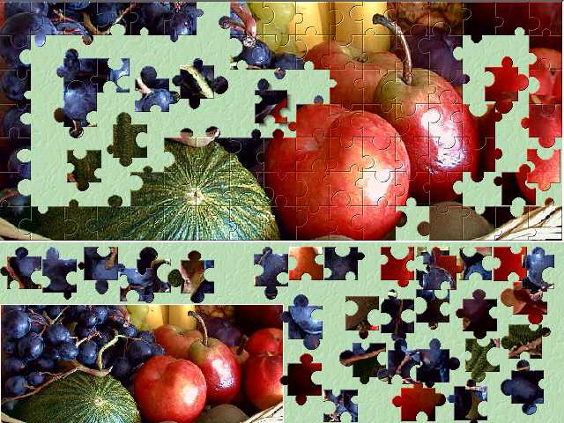
Jigsaw puzzles – Intuitive usage of Simulated Annealing
Given a jigsaw puzzle such that one has to obtain the final shape using all pieces together.
Starting with a random configuration, the human brain unconditionally chooses certain moves that tend to the solution.
However, certain moves that may or may not lead to the solution are accepted or rejected with a certain small probability.
The final shape is obtained as a result of a large number of iterations.

Slide 49
Conclusions
Simulated Annealing algorithms are usually better than greedy algorithms, when it comes to problems that have numerous locally optimum solutions.
Simulated Annealing is not the best solution to circuit partitioning or placement. Network flow approach to solving these problems functions much faster.
Simulated Annealing guarantees a convergence upon running sufficiently large number of iterations.

Slide 50
Local beam search
Keep track of k states rather than just one
Start with k randomly generated states
At each iteration, all the successors of all k states are generated
If any one is a goal state, stop; else select the k best successors from the complete list and repeat.
In a local beam search, useful information is passed among the k parallel search threads.
The algorithm quickly abandons unfruitful searches and moves its resources to where the most progress is being made.

Slide 51
Summary
Best-first search = general search, where the minimum-cost nodes (according to some measure) are expanded first.
Greedy search = best-first with the estimated cost to reach the goal as a heuristic measure.
- Generally faster than uninformed search
- not optimal
- not complete.
A* search = best-first with measure = path cost so far + estimated path cost to goal.
- combines advantages of uniform-cost and greedy searches
- complete, optimal and optimally efficient
- space complexity still exponential

Slide 52
Summary
Time complexity of heuristic algorithms depend on quality of heuristic function. Good heuristics can sometimes be constructed by examining the problem definition or by generalizing from experience with the problem class.
Local search methods can get stuck in local extreme; simulated annealing provides a way to escape local extreme, and is complete and optimal given a slow enough cooling schedule.

